Slide 1
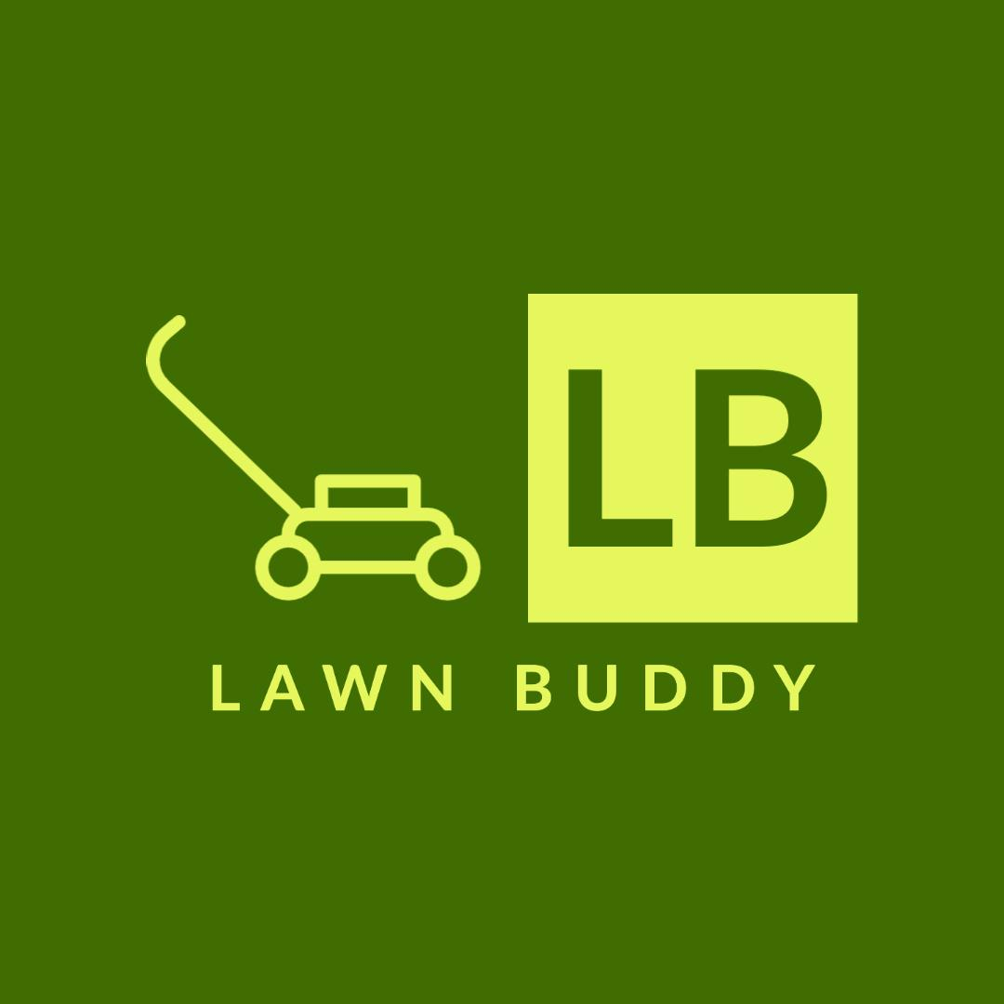




Why Object Recognition?
Classification
Localization
Tagging
Lawn detection
Lawn size
Lawn quality
Notes:
Hi everyone [pause] this is Gasser Ahmed [pause] I’m the CTO here at Lawn Buddy [pause] I’m going to talk about why we chose [pause] Object Recognition for our Lawn Buddy app
[pause]
We use object recognition [pause] so we can use 3 main features [pause][click] classification [pause] to detect the lawn [pause][click] localization to determine lawn size [pause][click] and tagging to find the lawn quality

Slide 2



Why Object Recognition?
Build
Measure
Learn
Built the minimum viable version of Lawn Buddy
Measured customer’s data and translated it into insights
Learned about the customer’s needs
Build, measure, learn
Notes:
We decided to use this technology after applying [pause] one of the key principles [pause] of the Lean Startup Methodology, [pause][click] the “Build, measure, learn” principle
[pause]
Using this principle [pause] we were able to [pause] [click] build the minimum viable version of [pause] Lawn Buddy [pause] [click] measure customer’s data [pause] and translate it into insights [pause] and lastly [pause] [click] learn about the customer’s need [pause] of something they can use [pause] to interpret and understand [pause] the logistical nature [pause] of the lawn care services needed
[pause]
Thank you!
[pause] so when you go to instagram or walmart.com or facebook [pause] and
and you're interacting with those apps [pause] that is [pause] the reactJS side
of things [pause] that you're interacting with

